Slide 1
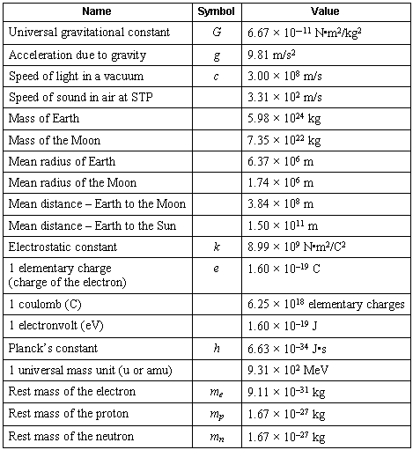
Scientific Notation

Slide 2
Scientific Notation
Do Not Write
In science, we deal with some very LARGE numbers:
1 mole = 602000000000000000000000
In science, we deal with some very SMALL numbers:
Mass of an electron =
0.000000000000000000000000000000091 kg

Slide 3
Imagine the difficulty of calculating the mass of 1 mole of electrons!
0.000000000000000000000000000000091 kg
x 602000000000000000000000
???????????????????????????????????
Do Not Write

Slide 4
Write ☺
Scientific Notation:
A method of representing very large or very small numbers in the form:
M x 10^{n}
M is a number between 1 and 10
n is an integer

Slide 5
How to change a # into Scientific Notation
#1: Insert an understood decimal point
#2: Decide where the decimal must end
up so that one number is to its left
#3: Count how many places you bounce
the decimal point
#4: Re-write in the form M x 10^{n}. Keep
significant figures only

Slide 6
.
2 500 000 000
9
8
7
6
5
4
3
2
1
Step #1: Insert an understood decimal point
Step #2: Decide where the decimal must end
up so that one number is to its left
Step #3: Count how many places you bounce
the decimal point
Step #4: Re-write in the form M x 10^{n}

Slide 7
2.5 x 10⁹
Moved decimal 9 times

Slide 8
0.0000579
1
2
3
4
5
Step #2: Decide where the decimal must end
up so that one number is to its left
Step #3: Count how many places you bounce
the decimal point
Step #4: Re-write in the form M x 10^{n}

Slide 9
5.79 x 10⁻⁵
#’s less than 1 have a negative exponent

Slide 10
Scientific Notation → Normal (10⁰)
Positive Exponent = Big #
Negative Exponent = Small #
1.5 x 10⁵
→150,000
0
0
0
1.5
0
1
2
3
4
5

Slide 11
Scientific Notation → Normal (10⁰)
2.7 x 10⁻³
→0.0027
.
0
0
2.7
3
2
1

Slide 12
up
Down
LA
RS

Slide 13
Fixing problems that are not in proper scientific notation
2
3
45.26 x 10
4.526 x 10
1
LARS

Slide 14
Fixing problems that are not in proper scientific notation
-3
-7
0.000561x10
5.61 x 10
1
2
3
4
LARS

Slide 15
Fixing problems that are not in proper scientific notation
-2
-4
789.25 x 10
7.8925 x 10
2
1
LARS

Slide 16
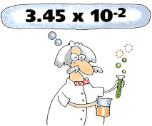
PERFORMING CALCULATIONS IN SCIENTIFIC NOTATION
ADDITION AND SUBTRACTION

Slide 17
Review:
Scientific notation expresses a number in the form:
M x 10^{n}
n is an integer
1 ≤ M < 10

Slide 18
4 x 10⁶
IF the exponents are the same, we simply add or subtract the numbers in front and bring the exponent down unchanged.
+ 3 x 10⁶
7
x 10⁶

Slide 19
The same holds true for subtraction in scientific notation.
4 x 10⁶
- 3 x 10⁶
1
x 10⁶

Slide 20
4 x 10⁶
If the exponents are NOT the same, we must move a decimal to make them the same.
+ 3 x 10⁵

Slide 21
4.00 x 10⁶
4.00 x 10⁶
+ 3.00 x 10⁵
+ .300 x 10⁶
4.30
x 10⁶
Move the decimal on the smaller number!

Slide 22
A Problem for you…
2.37 x 10⁻⁶
+ 3.48 x 10⁻⁴

Slide 23
Solution…
002.37 x 10⁻⁶
2.37 x 10⁻⁶
+ 3.48 x 10⁻⁴

Slide 24
Solution…
0.0237 x 10⁻⁴
+ 3.48 x 10⁻⁴
3.5037 x 10⁻⁴
3.50 x 10⁻⁴

Slide 25
Multiplication and Division When multiplying numbers in scientific notation, first multiply the numbers in front and then add the exponents.
add
(2 x 10⁶) x (3 x 10⁶)
= 6
x 10¹²

Slide 26
Multiplication and Division When dividing numbers in scientific notation, first divide the numbers in front and then subtract the exponents.
subtract
(4 x 10⁶) ÷ (2 x 10³)
= 2
x 10³

Slide 27
Multiplication and Division If the product of the two numbers is no longer in scientific notation, move the decimal and adjust the exponent
add
(5.00 x 10¹⁵) x (2.00 x 10²)
= 10.0
x 10¹⁷
= 1.00 x 10¹⁸
1

