Slide 1
Scientific Measurement
Unit 1

Slide 2
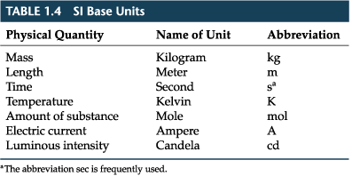
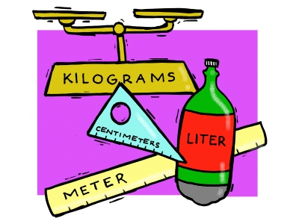
A. SI Units

Slide 3
B. Qualitative Measurement Vs. Quantitative Measurement
Qualitative
Deals with description (senses)
Data can be observed but not measured
Colors, textures, smells, tastes, appearance, beauty, etc.
Qualitative→Quality

Slide 4
B. Qualitative Measurement Vs. Quantitative Measurement
Quantitative
Deals with numbers
Data can be measured
Length, height, area, volume, weight, speed, time, temperature, humidity, cost, members, age, etc.
Quantitative→Quantity

Slide 5
C. Accuracy Vs. Precision
Accuracy- how close a measurement is to the actual value
Precision- how close a measurement is to other measurements (repeatability)
https://www.youtube.com/watch?v=hRAFPdDppzs

Slide 6
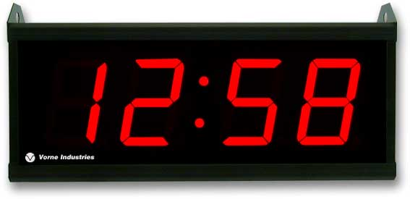
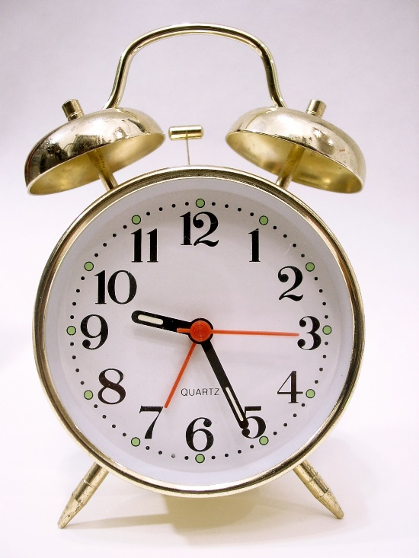
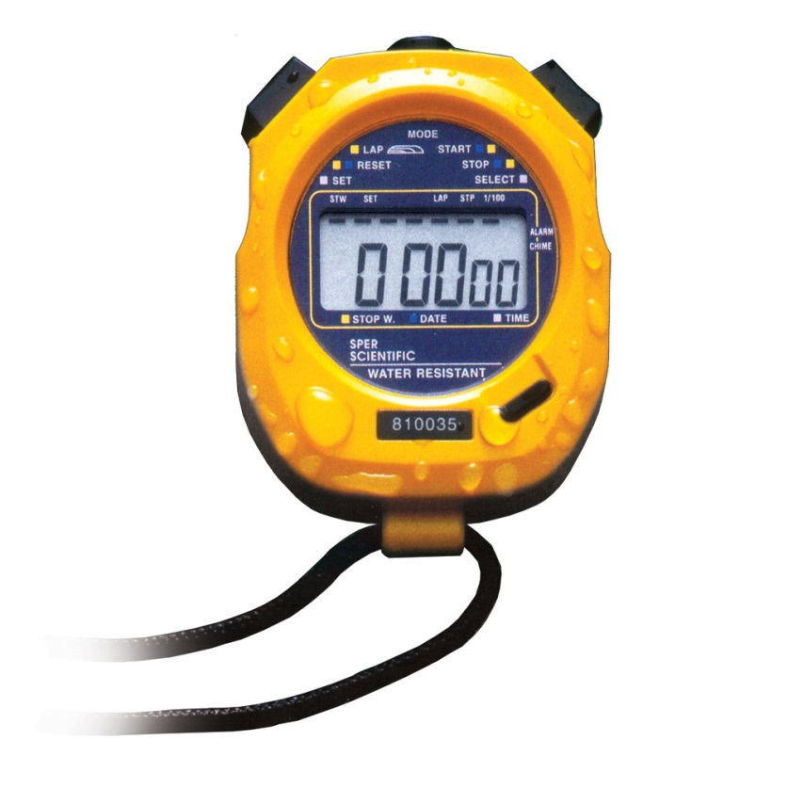
C. Accuracy Vs. Precision
2. Precision
Precision is based on the tools used
Indicated by the number of digits reported
Ex:
Seconds
Minutes
1/100 second

Slide 7
Which ruler will measure with greater precision?

Slide 8
Precision Vs. Accuracy
A
B
C
Which is not accurate or very precise?
Which is precise, but not accurate?
Which is both precise and accurate?

Slide 9
Example: Describe the accuracy and precision of each group’s measurements, if the actual length of the field was 29.55 meters.
Trial | Group A | Group B | Group C
1 | 40.55 m | 52.58 m | 29.25 m
2 | 35.65 m | 53.55 m | 29.85 m
3 | 22.89 m | 51.99 m | 29.50 m
Average
33.03 m
52.71 m
29.53 m
Accurate?
No
No
Yes
Precise?
No
Yes
Yes

Slide 10
4. Is it possible to be accurate and not precise? Group D: 2.55 m, 25.56 m, 60.54 m
Average: 29.55 m
No, The lack of precision in this data makes it untrustworthy so we would never call it accurate (just lucky)

Slide 11
D. Uncertainty in measurement
The accuracy of measurement is limited by the tool (instrument) we use.
When measuring, you must first write down the known digits (the digits you have lines for) and then the uncertain digit (the estimate)
A precise instrument is one that gives you a reading with many certain digits

Slide 12
D. Uncertainty in measurement
4. A ruler that follows a metric pattern can be broken down into tens. You can visually estimate the spaces into tenths. If a ruler has markings that are less than ten spaces then these can only be used to help you make an educated guess and do not add to the number of certain digits you can report.
0
1
2
3
4
0
1
2
3
4
cm
cm

Slide 13
3.7 cm
Ruler “A”
Which ruler(s) do you think is/are the most precise instruments?
cm
1
2
3
4
D
3.7 cm
Which ruler(s) only allow the marks to be used for making an educated guess?
Ruler “B”
B & C
cm
1
2
3
4
Which ruler(s) allow you to have your educated guess to be the least precise?
3.7 cm
B
Ruler “C”
cm
1
2
3
4
Which ruler(s) follow the metric pattern of all parts are broken into 10 equal parts?
3.65 cm
D
Ruler “D”
cm
1
2
3
4

Slide 14
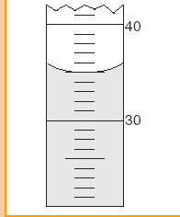
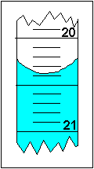
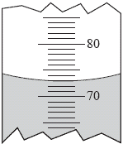
22
22.00 mL
21.63 mL
73
.0 mL
35.0 mL

